Slide 1
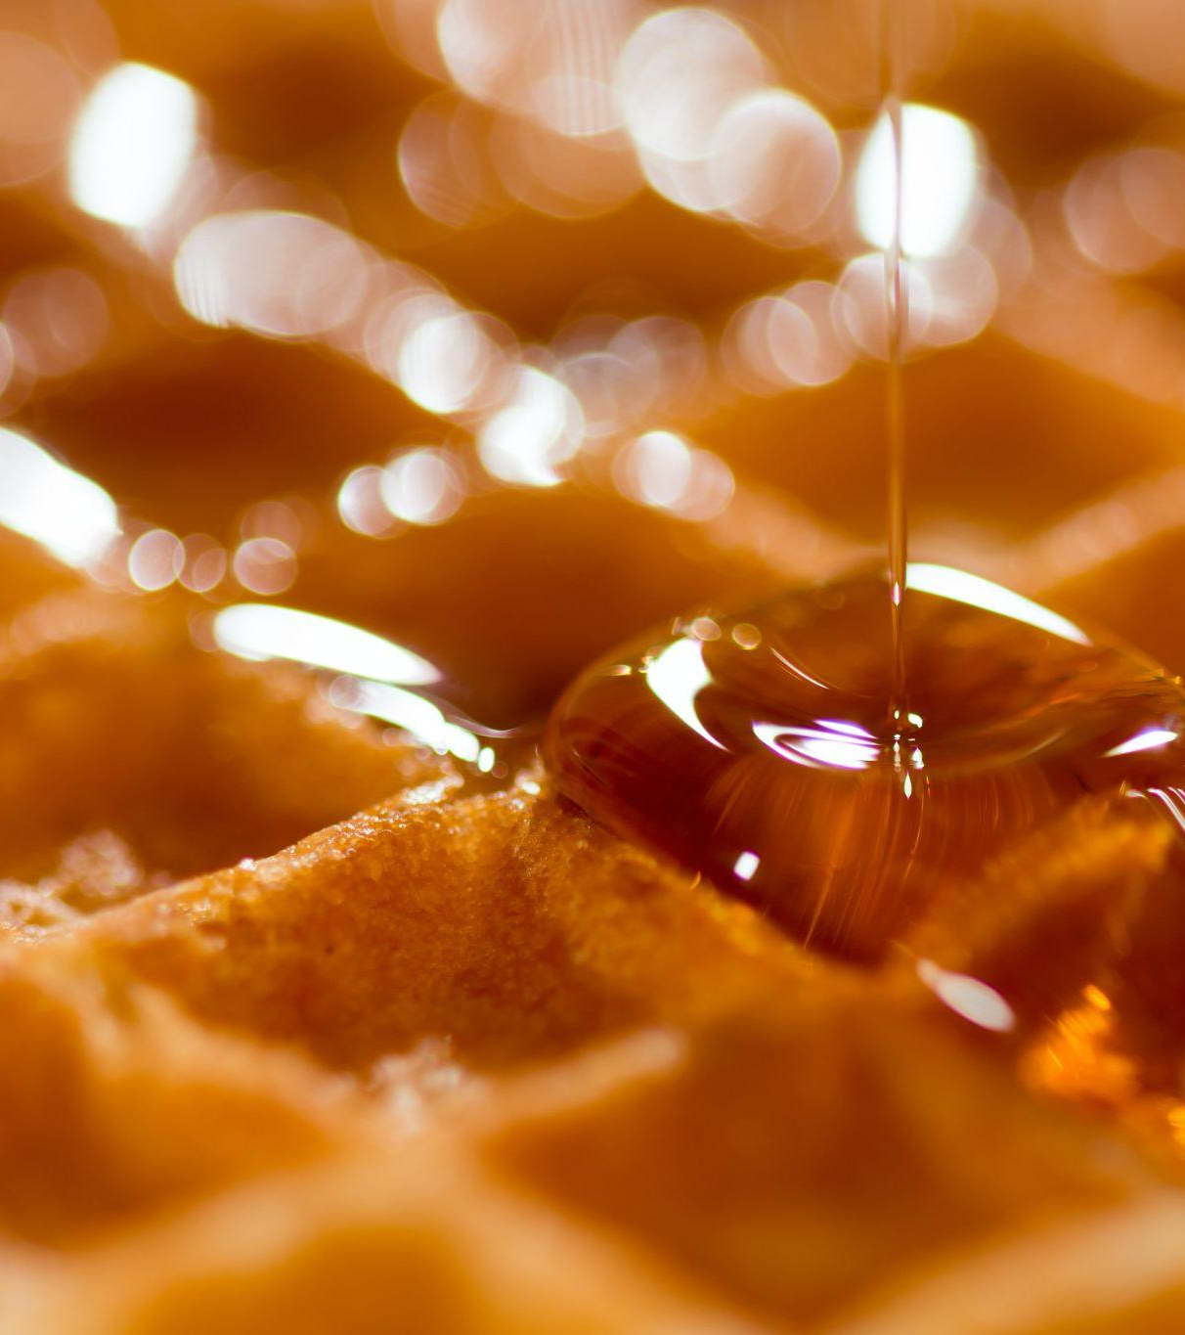
Quantification of sucrose in Canadian Maple Syrup by Fourier Transform Infrared Spectrometry (FTIR)
Donald Dillman & Alejandro Ruiz Caballero

Slide 2

Objectives
Develop
Experimentally develop a model to quantify the amount of sucrose in canadian maple syrups for future experiments.
Understand
Understand the importance of maple syrups and FTIR.
Identify
Identify all possible variables that were significantly affected in the results of the experiment.

Slide 3
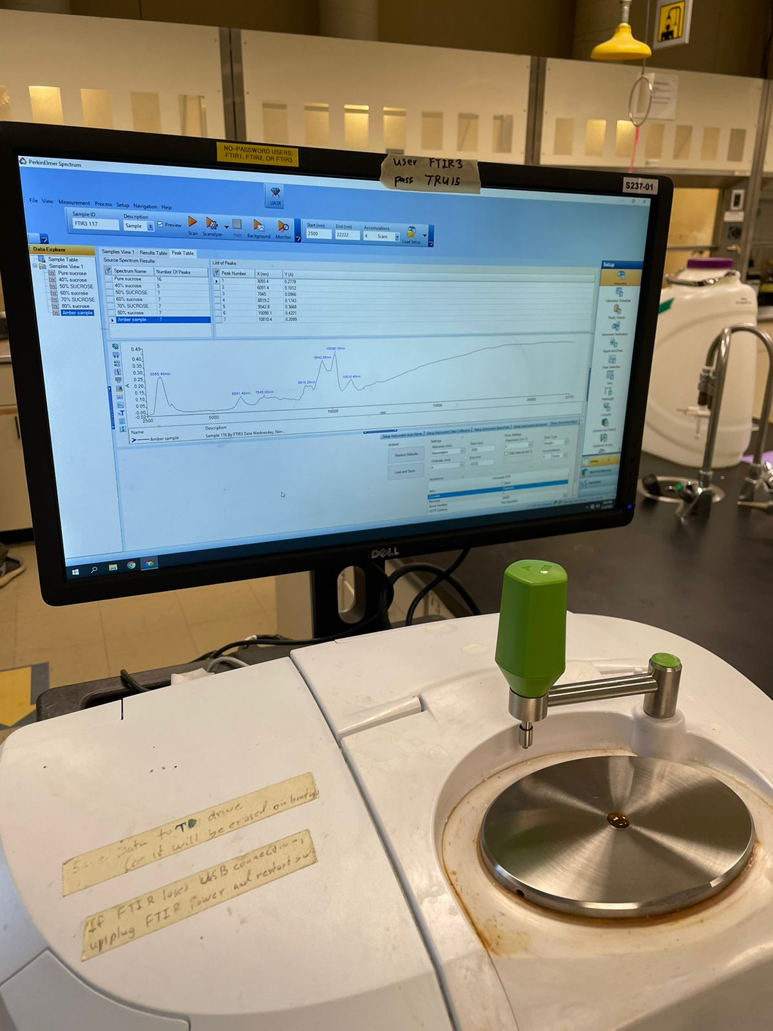
Introduction
Introduction
It is known that Canada has been the home of maple syrup, followed by the United States.
The consumption of maple syrup has been said to be healthy due to the natural sugars that are known to make it up. Sucrose has been identified as the main component.
The interpretation of the absorption infrared spectrum shows the determination of chemical bonds in a molecule. The absorption strength is proportional to concentration, which FTIR can be used for quantitative analysis.
In this experiment the sucrose content in different commercially available maple syrups was quantified.

Slide 4
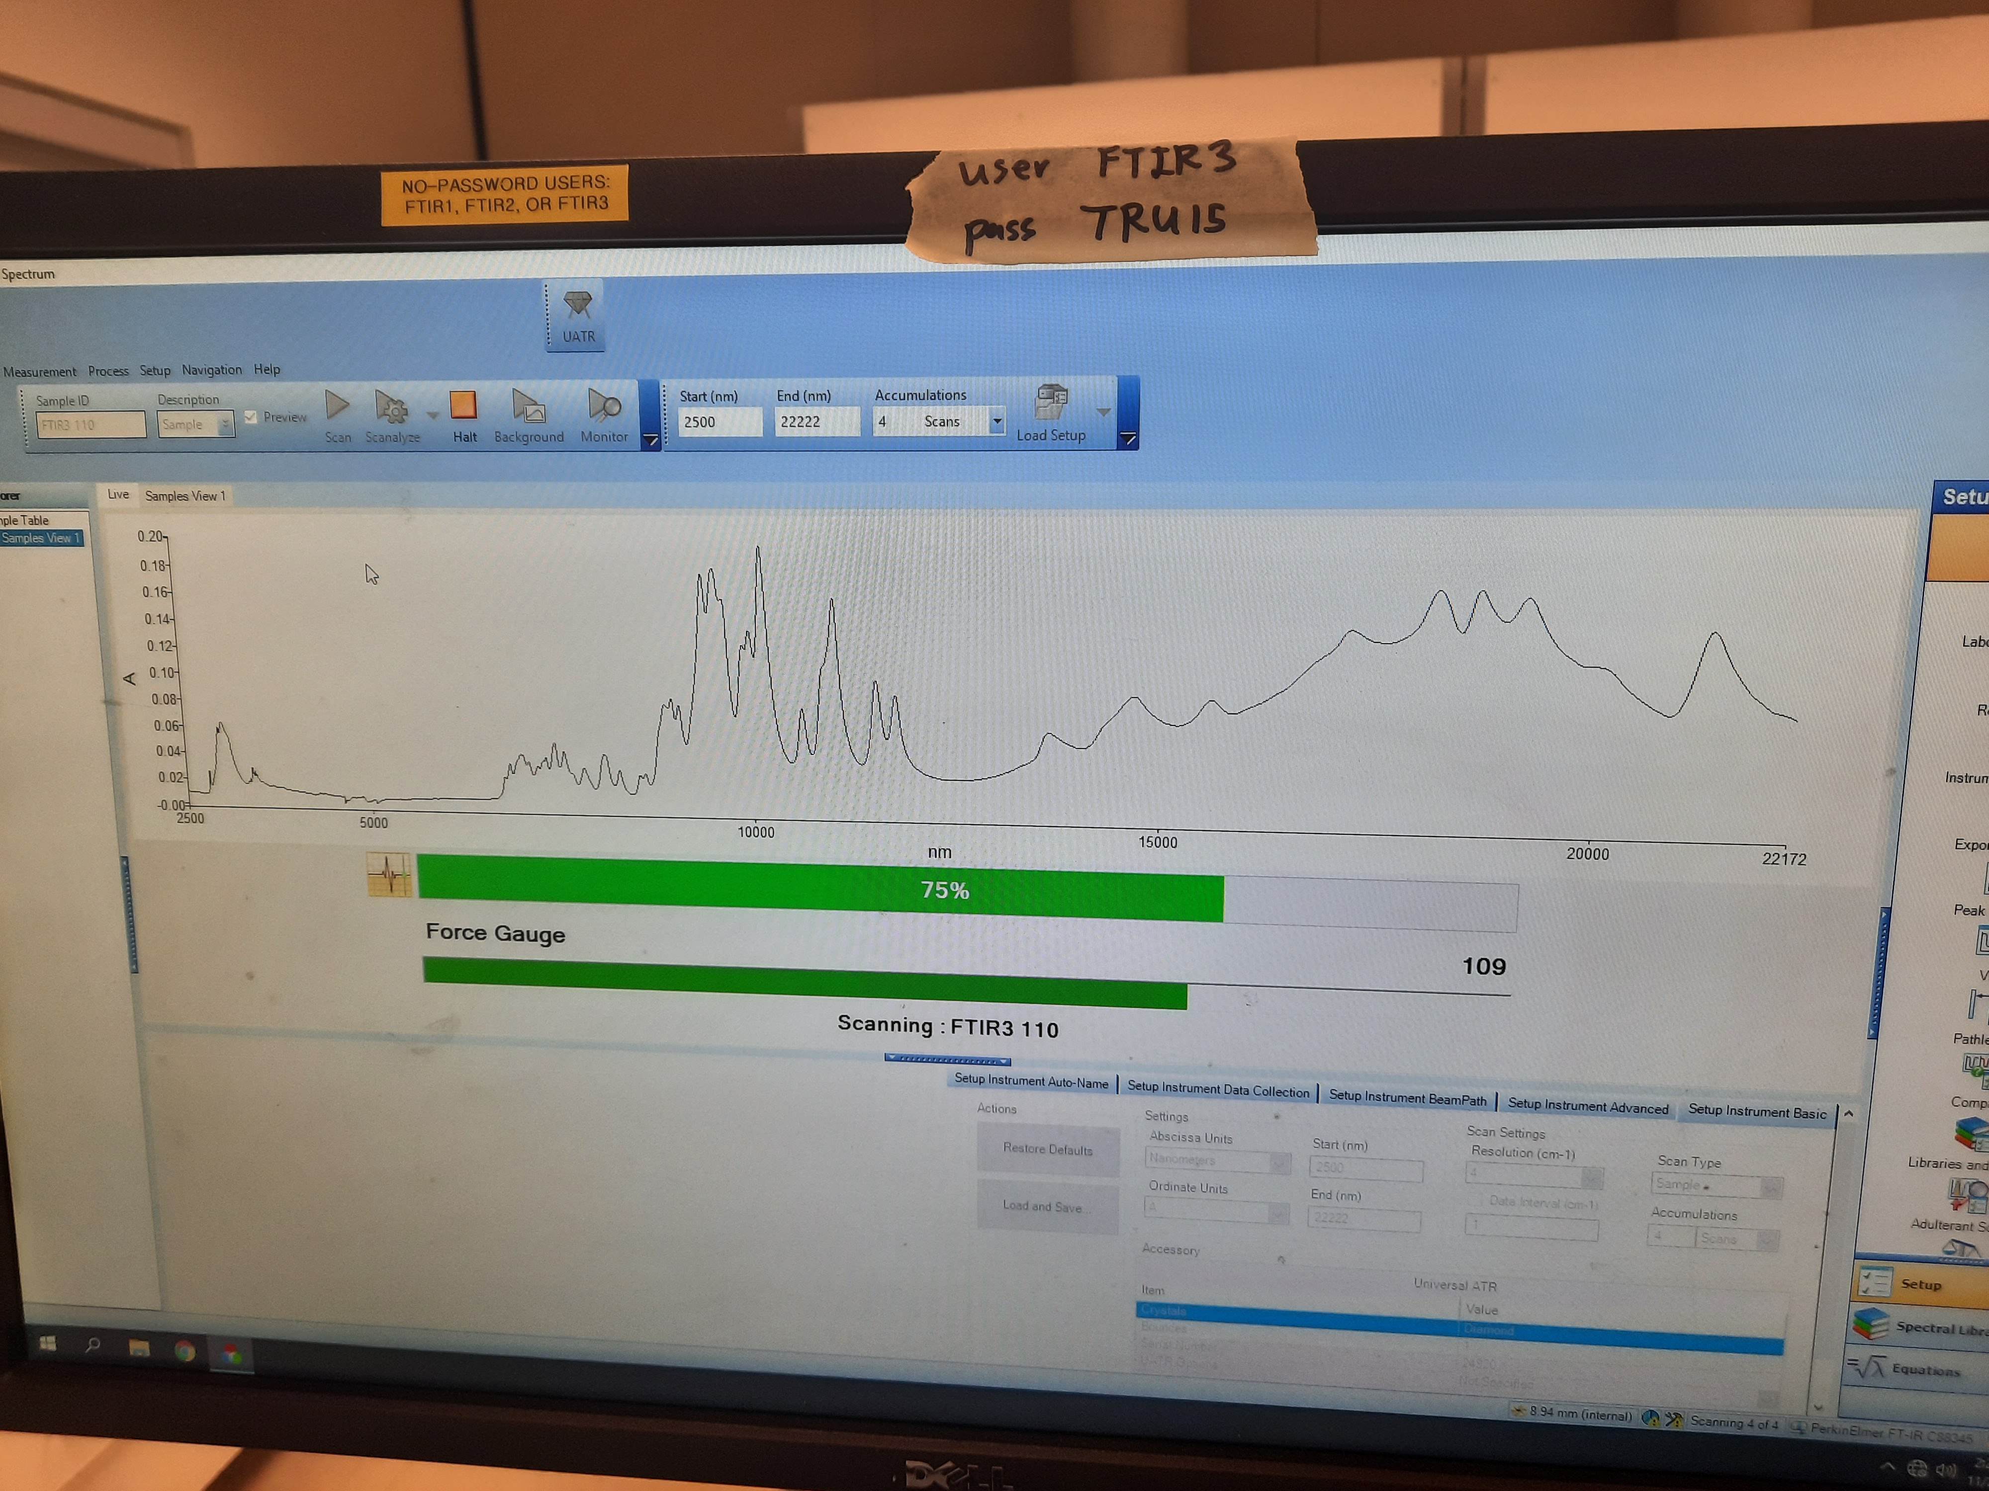
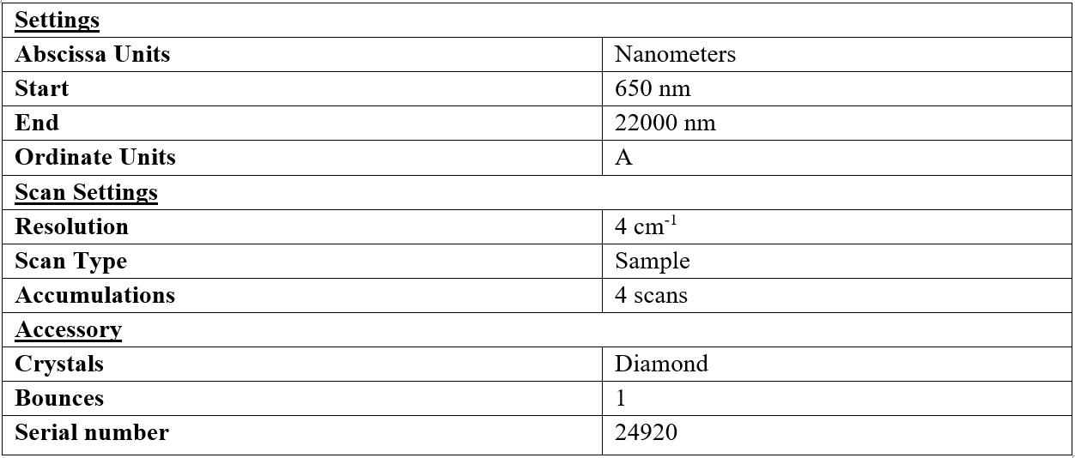
Instrument parameters

Slide 5
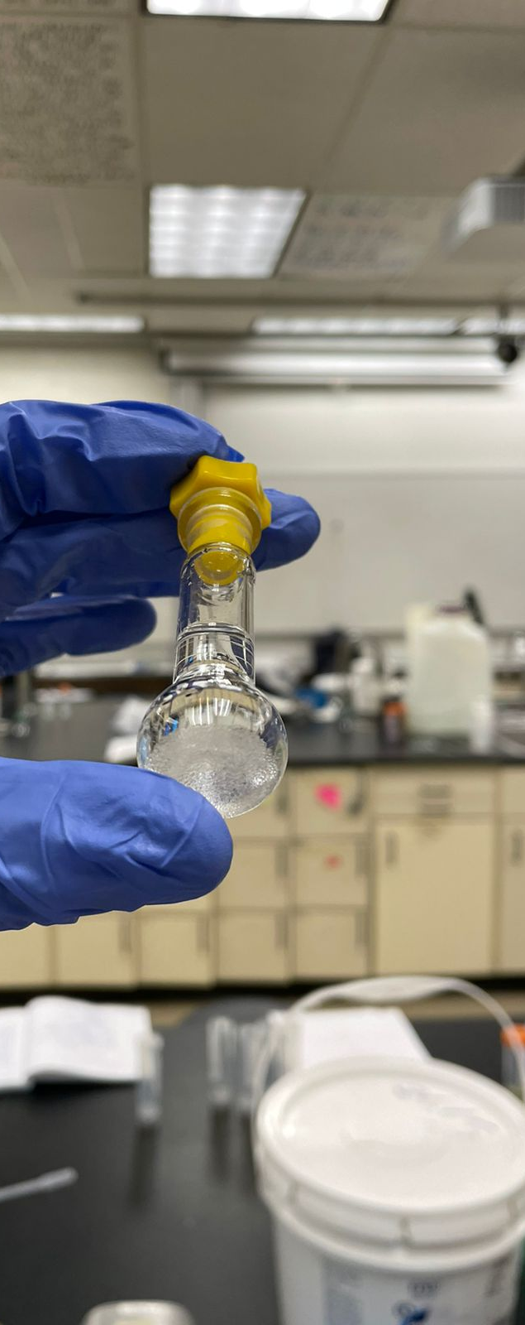
Experimental procedure
We had originally intended to have 50, 60 ,70, 80 and 90% as the calibration standard concentrations, but the solubility of sucrose in room temperature water only allowed for 1.8 g of sucrose to dissolve in 1 mL of water, for a 90% standard 4.5 g of sucrose were required, this already occupied most of the volume inside the flask and not enough water was able to fit inside the 5 mL volumetric flask to dissolve all the sucrose. New concentrations 40, 50, 60 ,70, 80 were made.
Standard were prepared by charging flasks with sucrose and dissolving them to the mark with water.
Samples were taken from each maple syrup bottle with plastic pipet.
Samples were poured in the FTIR for further analysis.

Slide 6
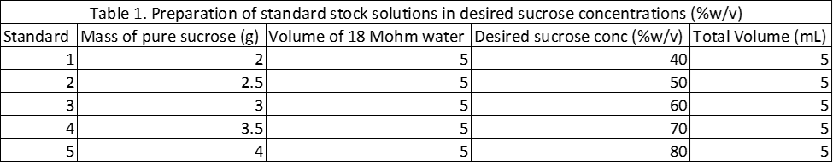
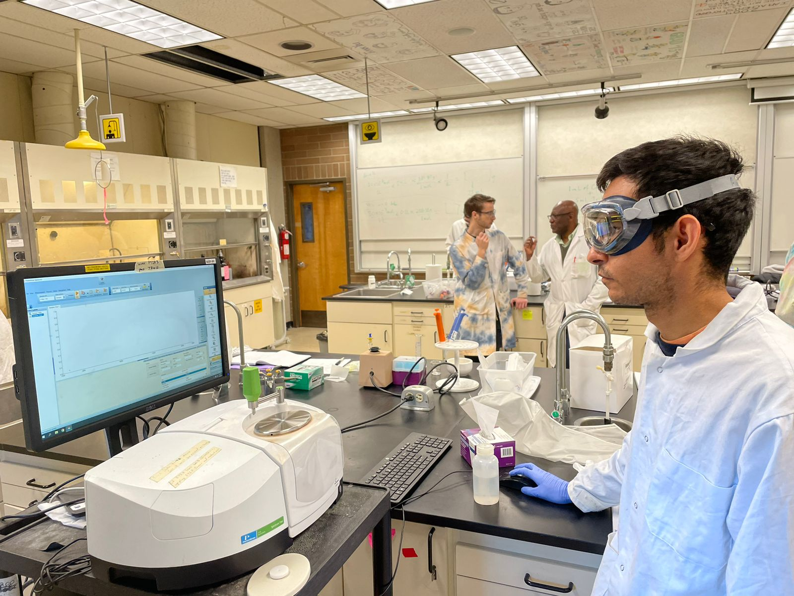
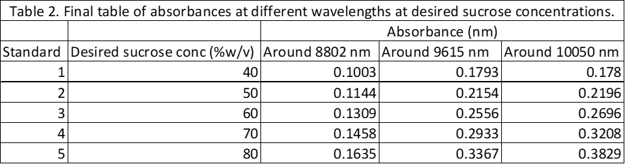
Data and Results

Slide 7
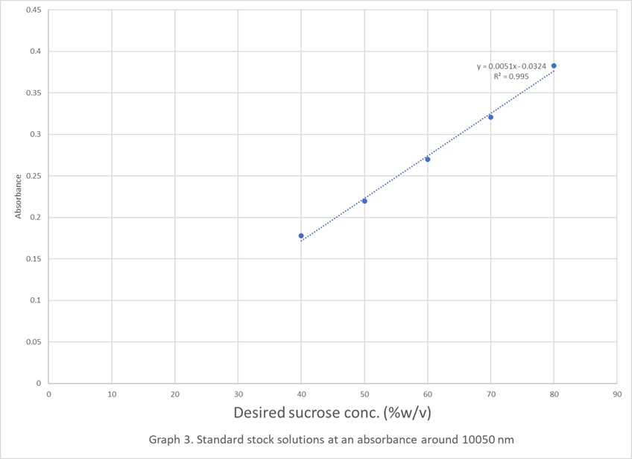

Slide 8
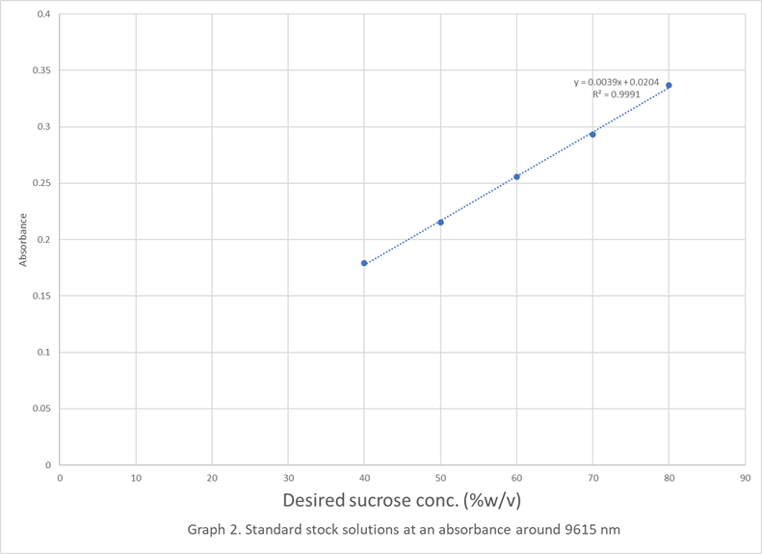

Slide 9
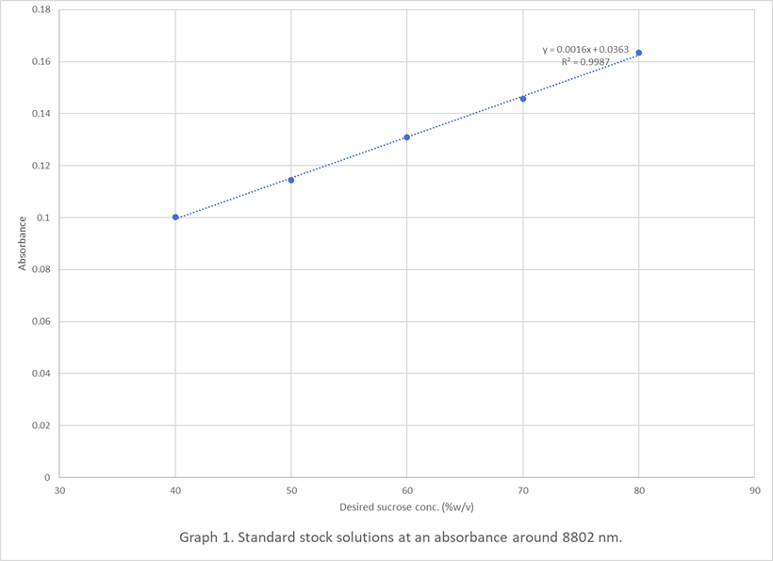

Slide 10
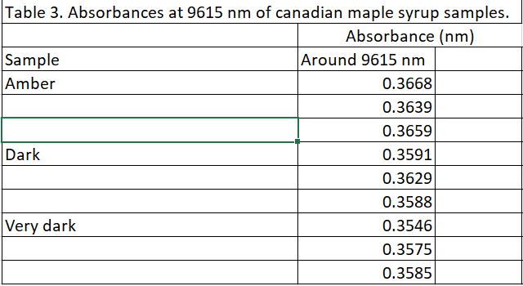

Slide 11
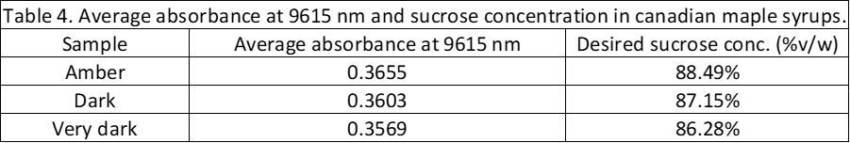

Slide 12


Calculations (sample)
Based on Graph 2, the equation of the line got calculated and got:
$y=0.0039x+0.0204$
An average absorbance at 9615 nm was obtained from the amber maple syrup to calculate the desired sucrose concentration:
$Average=\frac{0.3668+0.3639+0.3659}{3}=0.3655$
The average value got inserted into the equation of the line as for “y”:
$0.3655=0.0039x+0.0204$
$0.3655−0.0204=0.0039x$
$0.3451=0.0039x$
$x=88.49\%$ of desired sucrose concentration for amber maple syrup

Slide 13

To calculate the desired sucrose concentration (%v/w) for the standards were as follows:
For the Standard #1 at a concentration of 40%:
$\left(\%\frac{w}{v}\right)=\frac{mass of pure sucrose \left(g\right)}{Volume of 18 Mohm water \left(mL\right)}=\frac{2 gr}{5 mL}x 100\%=40\%$

Slide 15
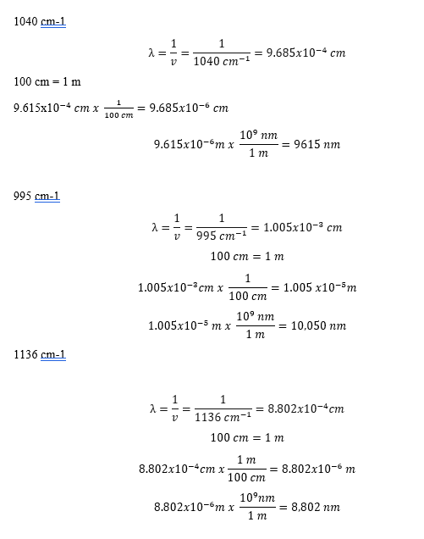
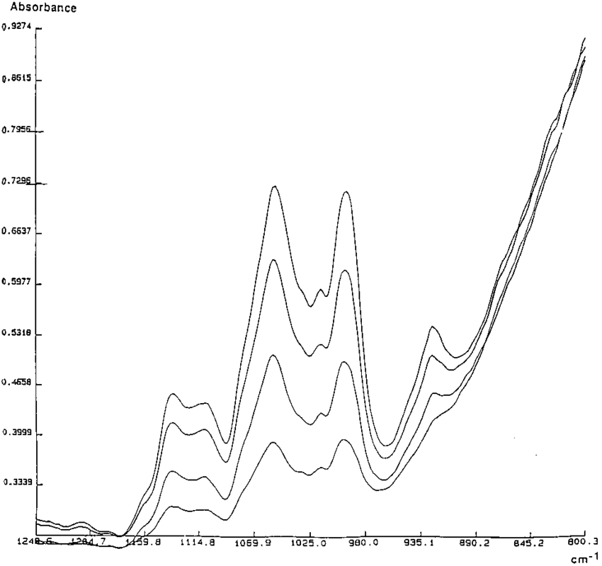
Discussion
Based on Frederick’s paper, the highlighted peaks of different concentrations of sucrose were recorded in wavenumbers. A conversion calculation was elaborated to show the wavelengths of the relevant peaks in nanometers. It was found that 3 peaks were identified in the standard sucrose solutions: 8802 nm, 9615 nm and 10050 nm.
Each of the standard’s absorbances in each wavelength were plotted against the sucrose desired concentrations. From the 3 graphs, the graph that contained the highest regression coefficient would be the one used to calculate the sucrose percentage concentration from the equation of the line. Therefore, the wavelength that got chosen was 9615 nm, with an r-squared of 0.9981.
Absorbances of the standards as well as the absorbances of all maple syrup samples at the wavelength of 9615 nm had to match so that accurate data would be provided.
It was found out that amber maple syrup had the highest amount of sucrose as 88.49%. In the label, it mentions that it has 53 grams per 60 mL of serving, compared to the others. It was also found out that the relative standard deviation percent of amber maple syrup got 0.62%.
Uncertainties were calculated to evaluate the error percentage in the data obtained for the canadian maple syrup samples.
1136 cm-1
995 cm-1
1040 cm-1

Slide 16
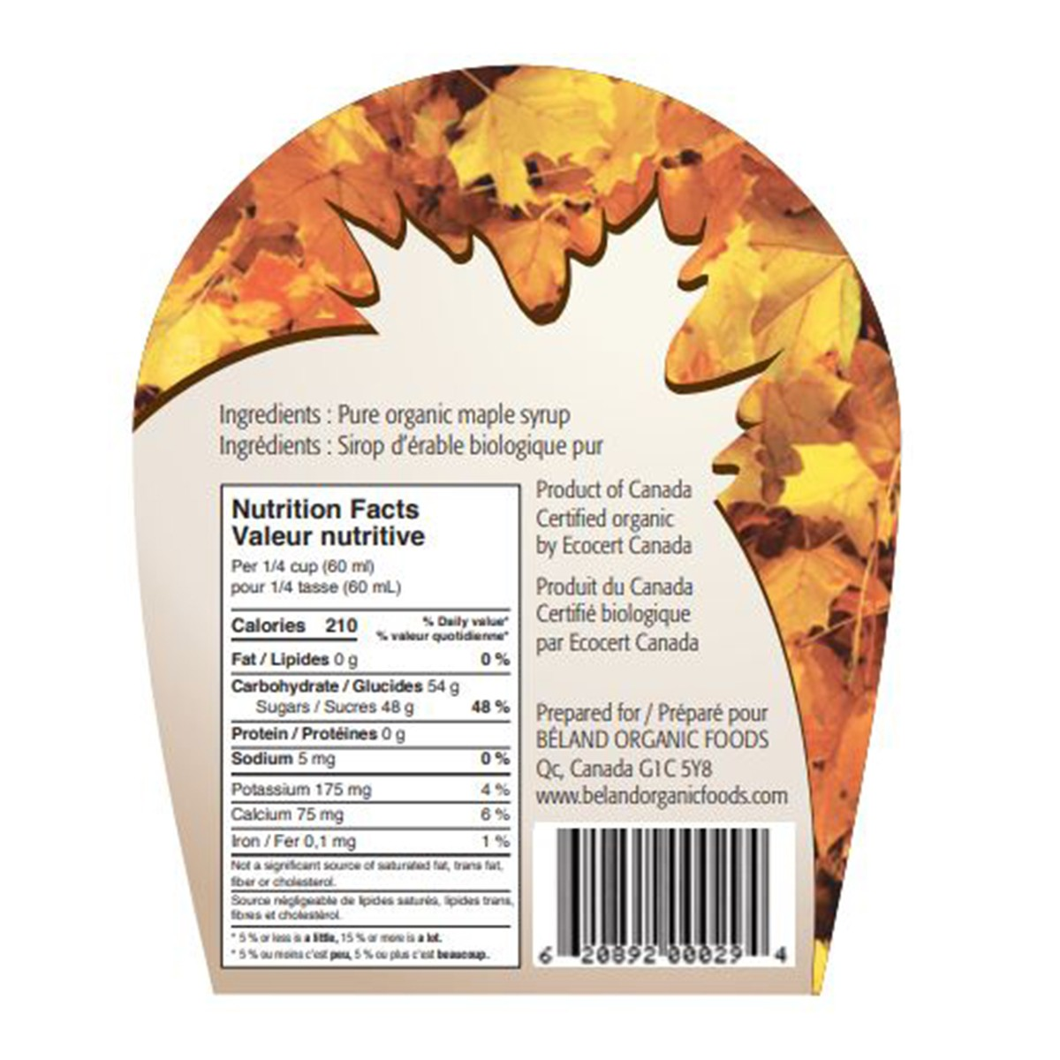
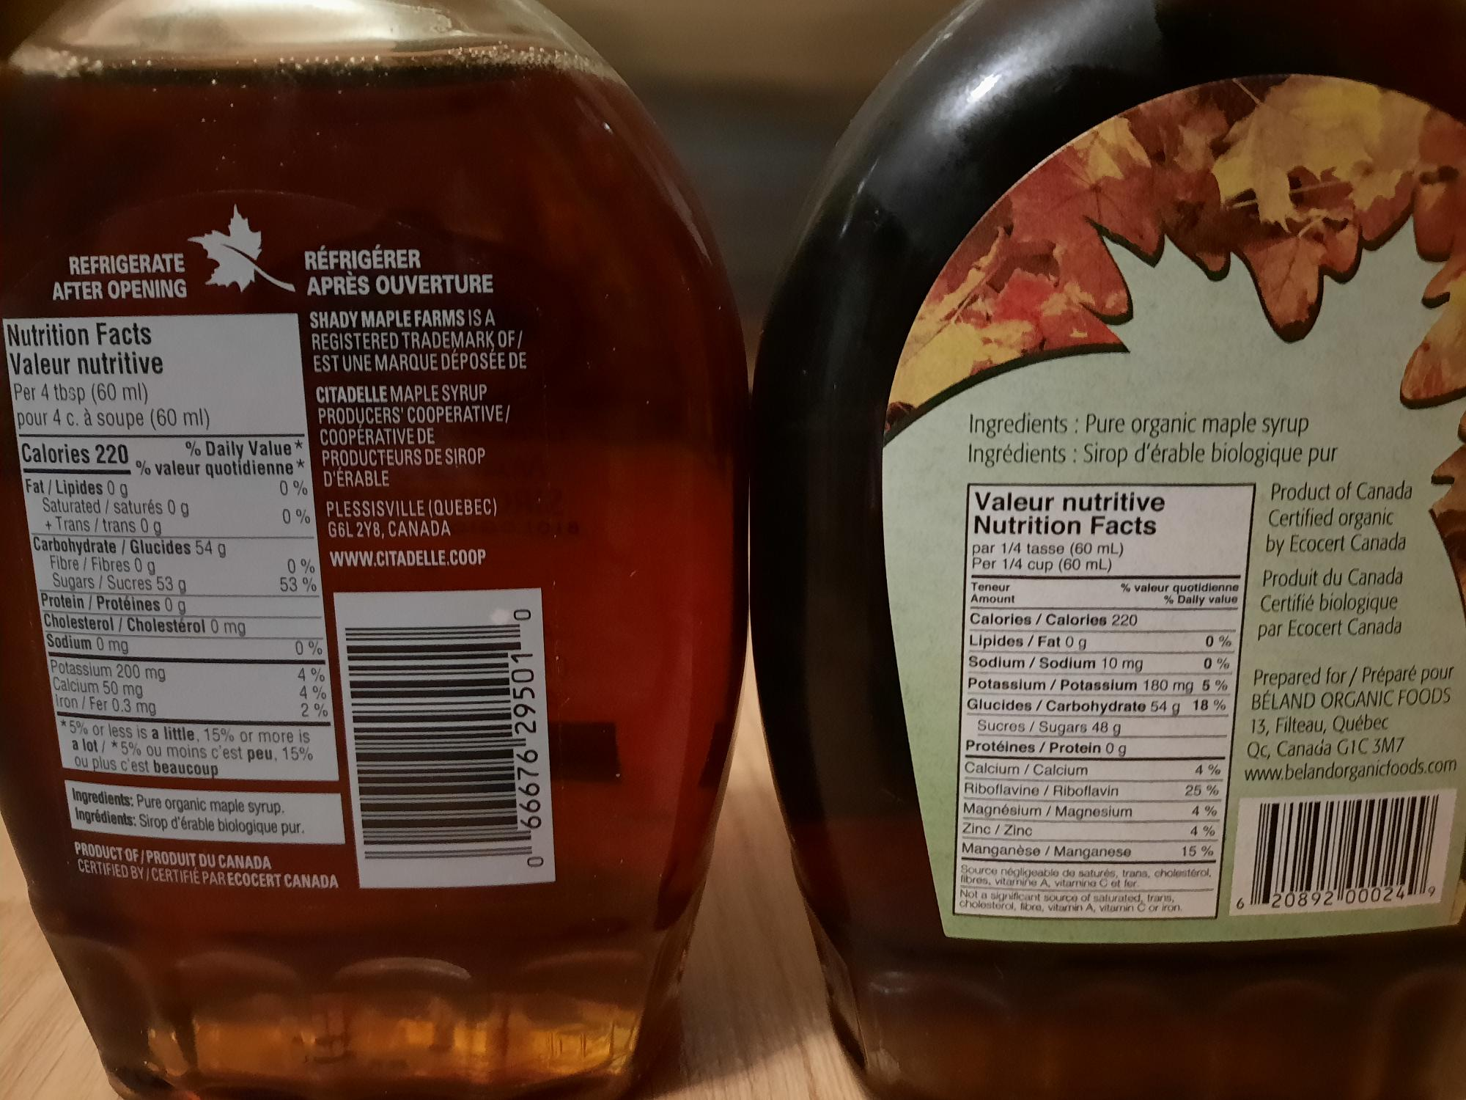
Amber
Dark
Very Dark

Slide 17
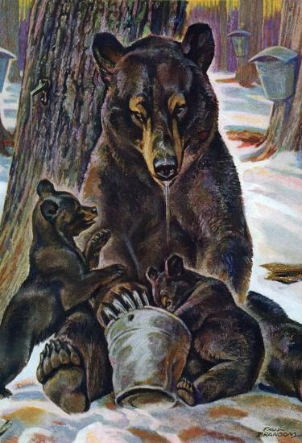
Conclusion
For this experiment, the use of Fourier transform infrared spectrometry was used to quantify the percentage of sucrose in canadian maple syrup. It was found out that the amber, dark and very dark maple syrup contained a concentration of sucrose of 88.49% ± 0.62%, 87.15% ± 0.63% and 86.28% ± 0.64%. The peak wavelength that was chosen resulted in being 9615 nm, with an equation of the line y=0.0039x + 0.00204, with an r-squared of 0.9981.

Slide 18
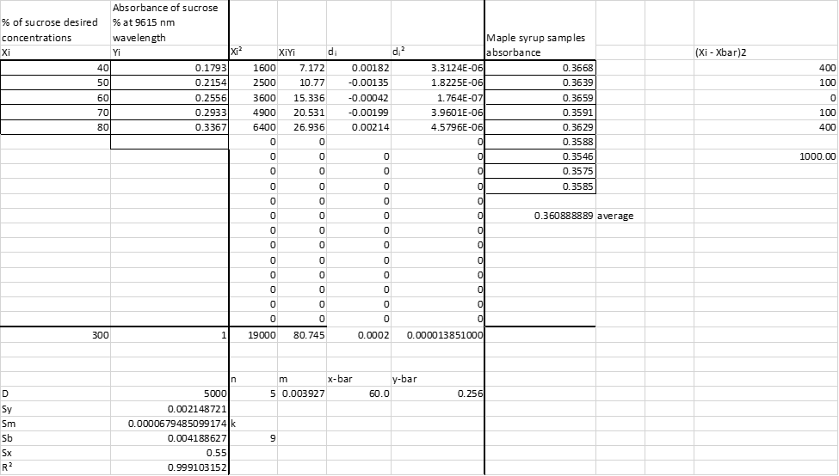
Appendix

Slide 19
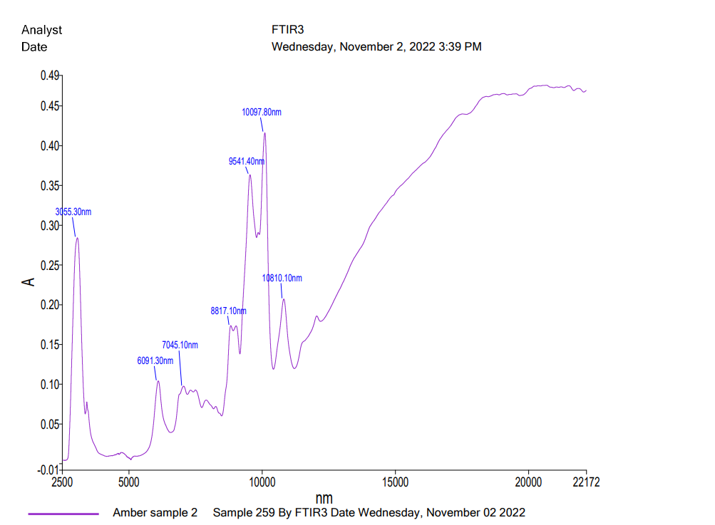

Slide 20
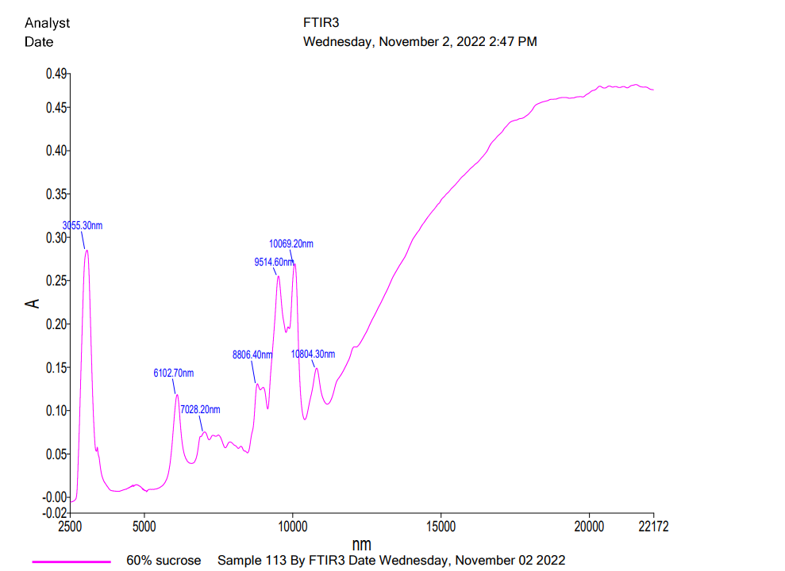

Slide 21
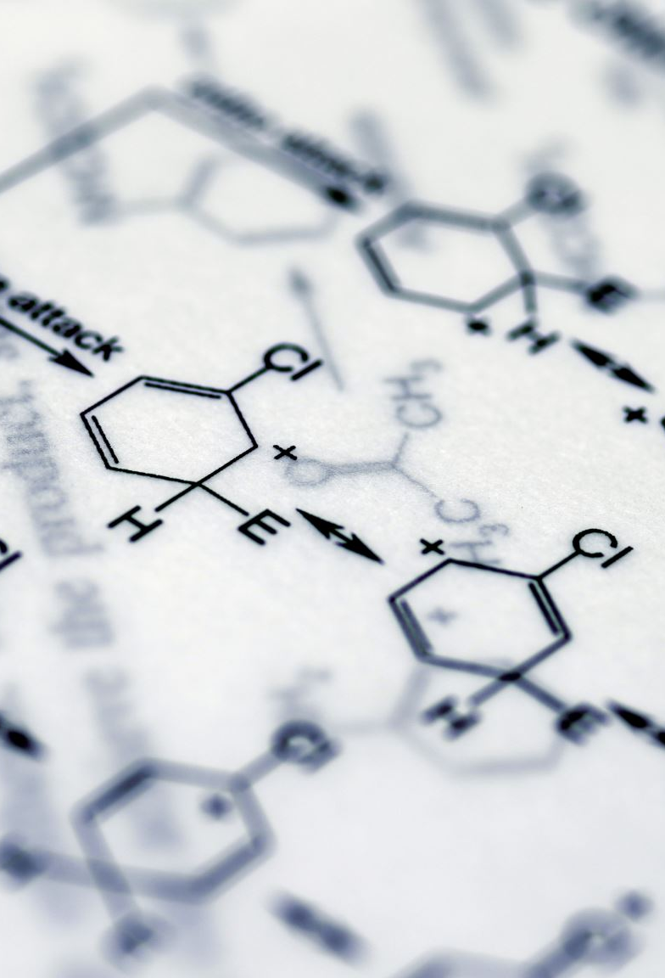
References
(1) Rubinson, K.A.; Rubinson, J. F. Contemporary Instrumental Analysis; Prentice Hall: Upper Saddle River, N. J. 1987.
Direct Spectroscopic Sucrose Determination of Raw Sugar Cane Juices - Scientific Figure on ResearchGate. Available from: https://www.researchgate.net/figure/Mid-FTIR-ATR-spectra-of-pure-sucrose-solutions-at-different-concentrations-10-20-30_fig3_231555198 [accessed 23 Nov, 2022]

